Slide 1
Retail Sales
Analysis
CUSTOMER & CAMPAIGN ANALYSIS
124,969 transactions · 6,884 customers · May 2011 to March 2015. Segmentation, campaign targeting and cohort retention, in Python and MySQL.
Rupsa Chaudhuri
Data Analyst · github.com/rupsa723
Notes:
The headline is that the analysis is sound but the dataset turns out to be generated, and the work that establishes that is the most interesting part.

Slide 2
Four questions
01
02
03
04
Who are the valuable customers?
Is the campaign worth targeting?
How often do people come back?
Do cohorts behave differently?
And at whom, for what return?
New in this version. It needs cohort analysis.
And how much of the business do they carry?
And when is someone lapsed?
One decision runs through all of it. The source file holds one row per transaction, but every question above is about a customer. Everything is computed on a 6,884-row customer table.
Notes:
The grain point matters more than it sounds. A customer with 39 purchases would otherwise be counted 39 times in any average, so frequent buyers would get a bigger vote than everyone else.

Slide 3
The data, and one thing to know before reading any chart
124,969
6,884
Both end months are half months
transactions
customers
The file opens on 16 May 2011 and closes on 16 March 2015. Each of those months covers 16 days, against about 2,729 transactions in a full one.
8,122,378
47
total value
months covered
Every monthly figure here is divided by days covered. Without that, three findings appear that are not real.
31 rows had no campaign response value and were dropped. Six exact duplicates found and recorded.
Source: Kaggle retail transaction dataset (regivm/retailtransactiondata). No currency given; figures are unlabelled units.
Notes:
This is the check that pays for itself. Three findings in the first version came from comparing months of different lengths.

Slide 4
Three value tiers
SEGMENTATION
Segment | Customers | % of base | Purchases | Total spend | % of revenue
P0 | 1,904 | 27.7% | 24.45 | 1,728.28 | 40.5%
P1 | 2,906 | 42.2% | 18.19 | 1,226.01 | 43.9%
P2 | 2,074 | 30.1% | 12.32 | 611.83 | 15.6%
P0 and P1 differ in frequency, not basket
Read them as a ranking
24.45 purchases against 18.19, but baskets of 70.76 and 67.61. P2 is lower on both.
They are tiers of value, not three different kinds of customer. The next slide shows why.
Notes:
K-means on standardised purchase count and total spend, fitted on the customer table rather than on transaction rows.

Slide 5
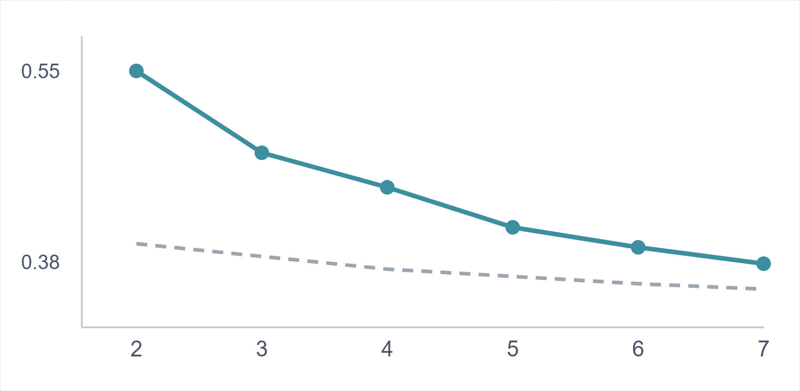
There are no natural clusters in this data
VALIDATION
No peak
The score falls steadily from k=2. A real cluster count would show a high point.
Barely above noise
Random points over the same range score 0.38–0.41. This data manages 0.46–0.54.
The customers lie on a line
Purchases and spend correlate at 0.93, and one component holds 96.7% of the variance.
——— this data
- - - random noise, same range
number of clusters (k) →
k=3 is kept as a workable banding of a continuum, and the limitation is stated rather than hidden behind an elbow that does not bend.
Notes:
This slide is the one to linger on. Saying "I checked whether the clusters were real and they are not" is a stronger answer than any elbow plot.

Slide 6
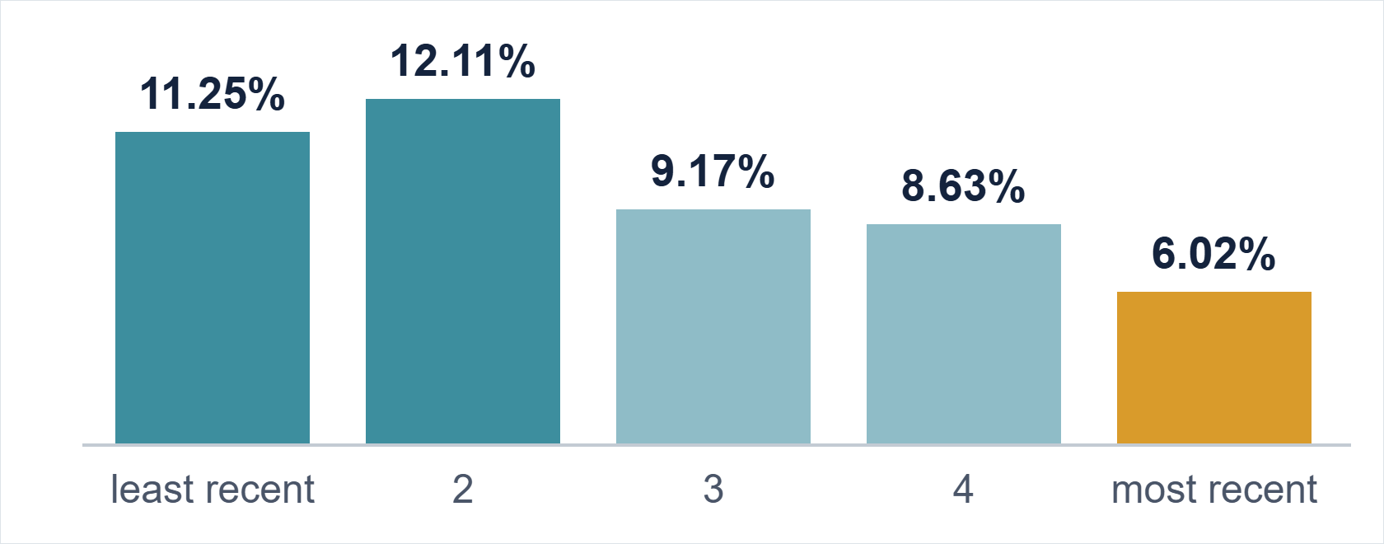
Recency runs backwards here
RFM SCORING
Response rate by recency group, least recent on the left:
Fixed cutoffs hid it
A 200-day "recent" threshold puts 6,303 of 6,884 customers in one bucket. The old finding compared almost everybody against 66 people.
At Risk responds best
23.17%, ahead of Champions at 11.58%. Standard RFM assumes the opposite.
Frequency is what separates
1.60% in the bottom group up to 18.08% in the top.
Reported as a property of this dataset, not a general rule. It becomes evidence for the conclusion later.
Notes:
Scored by quintile rather than fixed thresholds, because the median customer last bought 53 days ago.

Slide 7
Contact P0. Skip P2.
THE DECISION
P0
P1
P2
1.84x
1.00x
0.23x
27.7% of the base
50.9% of all responders
17.28% response rate
42.2% of the base
42.2% of all responders
9.39% response rate
30.1% of the base
7.0% of all responders
2.17% response rate
Mailing P0 alone
P1 is the marginal call
reaches half the responders for about a quarter of the contact cost.
Adding it takes reach from 50.9% to 93.1%, but contact from 27.7% to 69.9% of the base.
Base response rate 9.40%, 647 of 6,884 customers. Cost per contact is not in the dataset, so the P1 trade-off is stated rather than answered.
Notes:
This is the slide that carries a decision. Everything before it is setup.

Slide 8
Projected 12-month value, checked against reality
CUSTOMER VALUE
Segment | Per customer | Segment total
P0 | 469.67 | 894,250
P1 | 338.20 | 982,808
P2 | 173.88 | 360,620
The sanity check
Projected across the base
2,237,678
Actually earned in the last 12 months
2,108,426
P1 holds the largest total because it is the biggest group. P0 is worth most per head. Those point at different decisions.
Ratio 1.06. On a flat business a forward estimate should land near one observed year, so this holds up.
Average order value × each customer's own monthly purchase rate × 12. No churn term, so it assumes they keep buying at their observed rate.
Notes:
Worth running a check like this on any derived number before reporting it. One ratio catches an entire class of error.

Slide 9
Set the reactivation trigger at 99 days
PURCHASE CADENCE
49
99
167
days, median gap between purchases
days covers 75% of all repeat purchases
days covers 90%
Average gap by segment
Set it per segment
P0 normally returns in 55 days and P2 in 104, so one global threshold misfires on both.
Segment | Mean | Median
P0 | 55.0 | 39.0
P1 | 72.9 | 52.0
P2 | 104.3 | 73.0
A month is too short a window
Someone buying at a normal 49-day rhythm is absent from about half of all calendar months. This decides the cohort period next.
Mean is pulled up by a long tail, so the median is the figure to quote. Maximum observed gap: 985 days.
Notes:
This is the most directly operational number in the whole project.

Slide 10
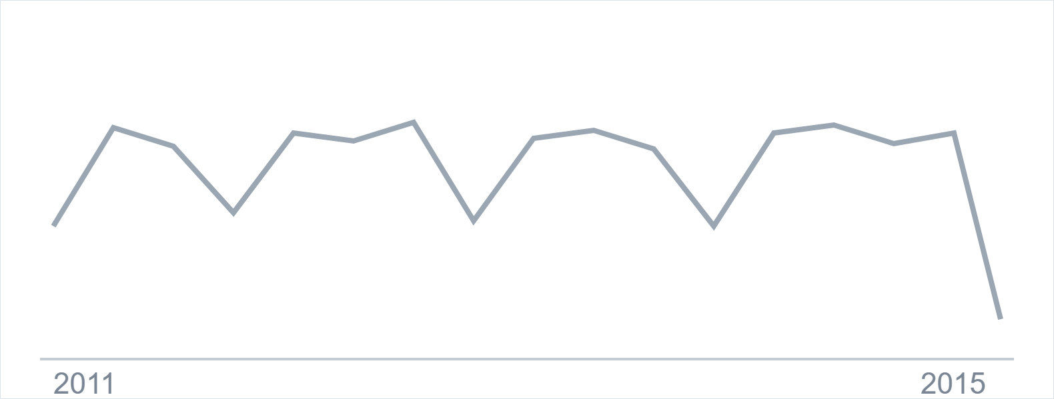
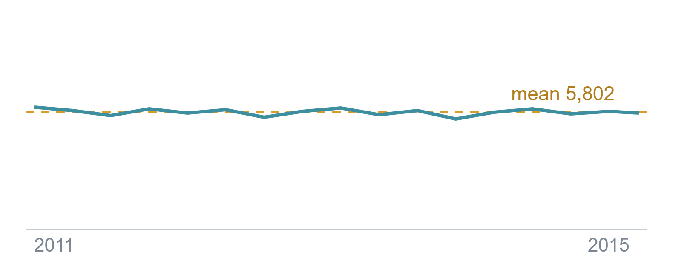
Same data, divided by days covered
SALES OVER TIME
Raw monthly revenue
Revenue per day of coverage
Looks volatile, with a collapse at the end.
Standard deviation 133. A spread of 2.3% across 47 months.
No seasonality
No trend
Per day, every calendar month sits between 87.9 and 90.3 transactions. April looked low only because it appears three times in the file while most months appear four.
The three complete years hold 32,521, 32,900 and 32,226 transactions. Average basket moves between 64.89 and 65.23 across five years.
The drop at the right-hand end of the raw chart is the file stopping on 16 March 2015.
Notes:
Show both charts together. The point is the difference between them, not either one alone.

Slide 11
Group customers by when they first bought
COHORT RETENTION
RFM scores everyone as of one date, so it says who is valuable now. It cannot say whether the customers you acquire are getting better or worse, because that needs tenure held constant. Rows are quarters of first purchase; columns are quarters since.
Cohort | Size | Q1 | Q2 | Q3 | Q4 | Q5 | Q6 | Q7 | Q8
2011 Q2 | 3,147 | 69.7 | 68.4 | 70.0 | 68.6 | 69.5 | 69.4 | 70.0 | 70.0
2011 Q3 | 2,543 | 68.5 | 69.2 | 68.2 | 69.7 | 68.6 | 69.4 | 69.6 | 70.8
2011 Q4 | 808 | 66.2 | 65.2 | 69.6 | 67.6 | 68.8 | 68.8 | 69.7 | 68.6
2012 Q1 | 237 | 61.2 | 62.4 | 64.6 | 62.9 | 61.2 | 62.9 | 70.9 | 64.6
Read across any row: no decay anywhere. Normally retention falls with tenure. This does not, which is the first sign something is wrong with the cohorts rather than with the business.
Quarterly, because the median gap is 49 days and a monthly grid would measure buying rhythm rather than retention. Cohorts under 100 customers excluded.
Notes:
Percentages are the share of each cohort active in that quarter.

Slide 12
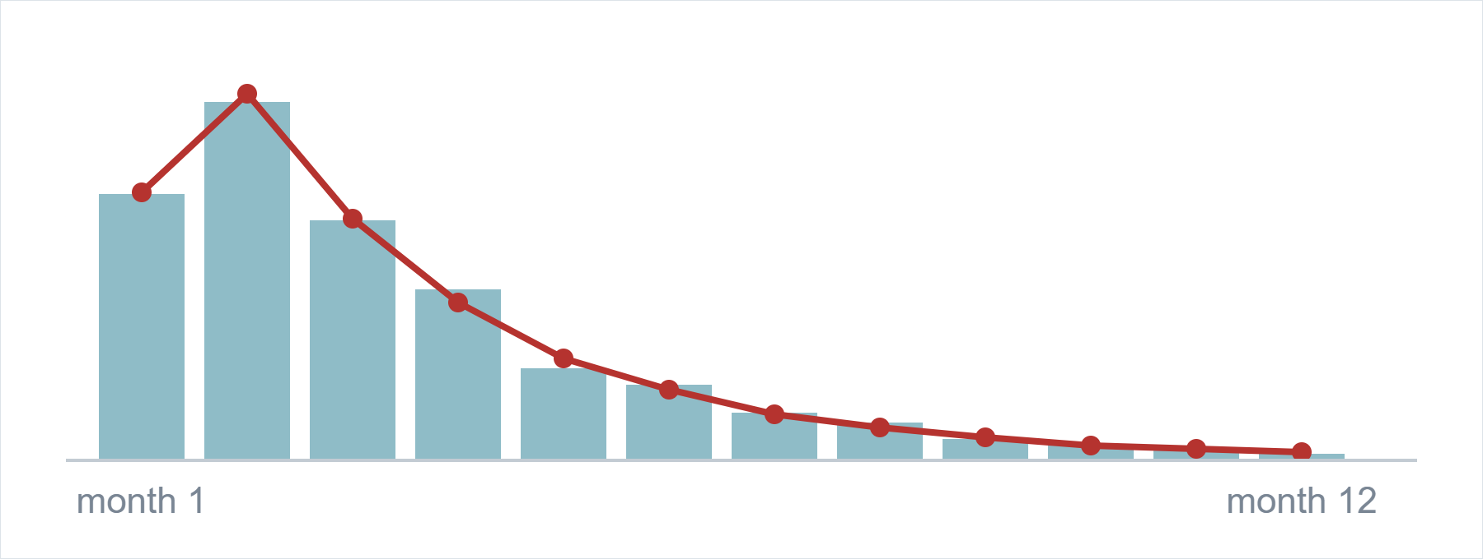
These are not acquisition cohorts
THE DIAGNOSTIC
Gaps between purchases are never cut off, so each customer's buying rate can be estimated from their own gaps. Then ask: if everyone already existed on day one, when would each first appear?
Over 14 months
6,810 predicted
6,826 observed
No fitted parameters. One assumption.
And no churn either
Only 38 customers of 6,884 stop buying before 2014. 61.4% have their last purchase in the final three months.
Closed at both ends
First purchase here means first appearance, not first ever.
▬ customers actually first seen
——— predicted if all pre-existing
The usual fix is to discard early cohorts. Here that would leave groups of nine customers or fewer, so the limitation is stated instead.
Notes:
The chance a customer has not appeared by day t is exp of minus lambda t, summed across all 6,884.

Slide 13
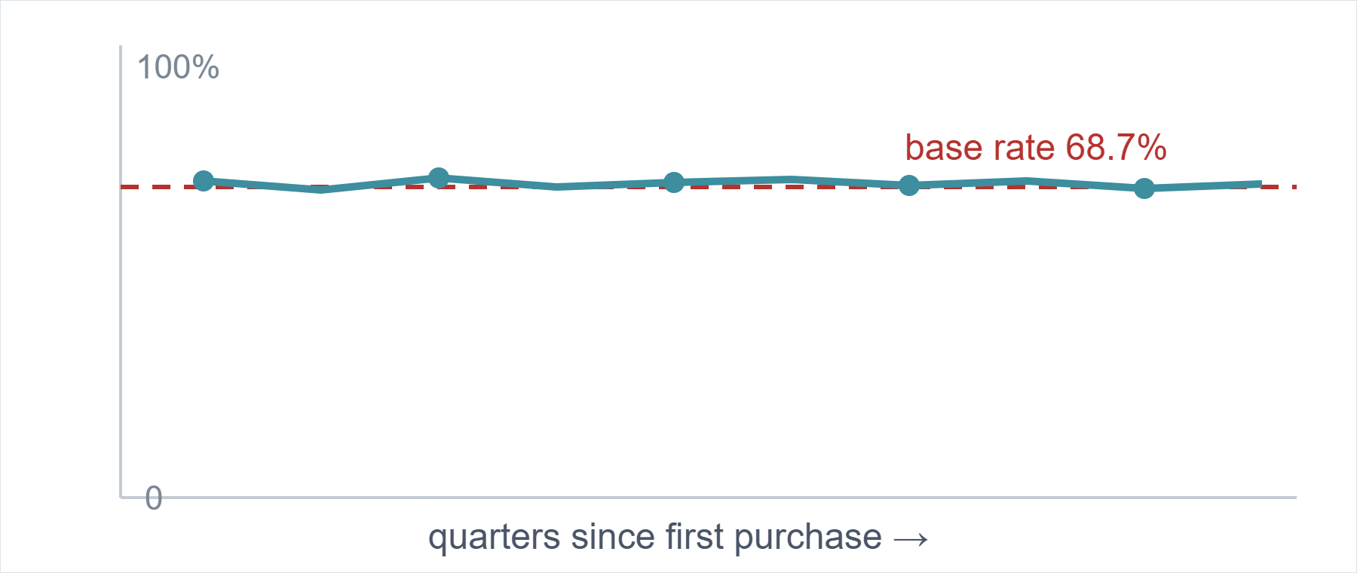
Retention sits exactly on the base rate
THE COMPARISON THAT MATTERS
Cohort retention
68.9%
Picking at random
68.7%
Knowing which cohort a customer belongs to, and how long they have been one, tells you nothing about whether they buy this quarter.
Monthly is the same story: 32.8% against 32.5%.
A number only means something next to what you would get by picking at random. A flat chart invites "so what"; a curve lying on the base-rate line answers it.
Notes:
This is the clearest way to present a null result. It says the finding rather than leaving the audience to infer it.

Slide 14
The flatness is the finding. This dataset is generated, not observed.
Revenue per day constant to within 2.3% across 47 months
Every calendar month between 87.9 and 90.3 transactions a day
Basket value moves half a percent across five years
No acquisition — 12 new customers in the last two years
No churn — 38 of 6,884 stop before 2014
Recency runs backwards against campaign response
A real retailer gains and loses customers, has busy and quiet periods, and drifts in basket size. None of that is here. So this is written up as a demonstration of method with its limits stated, rather than as business insight.
Notes:
Saying this plainly is worth more than reporting seasonal patterns that are not there. It is also the hardest part of the analysis to argue with.

Slide 15
What the analysis would support
RECOMMENDATIONS
01
Contact P0 first
27.7% of the base, 50.9% of responders, 1.84x lift. Half the responders for about a quarter of the contact cost.
02
Leave P2 out of broad mailings
30.1% of the base, 7.0% of responders, 0.23x. At equal cost per contact it returns under a quarter of average.
03
Trigger reactivation at 99 days, per segment
P0 normally returns in 55 days and P2 in 104, so one global threshold misfires on both.
04
Do not plan around seasonality
There is none in this data. Any calendar planning built on an April dip or August peak should be withdrawn.
Framed as what the analysis would support if the data were real.
Notes:
Four recommendations, each tied to a number on an earlier slide.

Slide 16

Stated up front, not left to be found
LIMITATIONS
The dataset appears generated
The response flag has no date
Findings demonstrate method, not a real business.
One static value per customer, so it cannot be tracked over time or tied to a campaign.
The segments are a banding
Purchases and spend correlate at 0.93 and silhouette has no peak. k=3 is a convention.
Recency behaves backwards
The opposite of what RFM practice assumes. Reported rather than explained away.
Cohorts are fully left-censored
Not just the early ones. The standard fix would leave groups of fewer than ten.
No causal claims are supported
Segments come from the same behaviour they are then used to describe.
The far end is right-censored
Any lifetime estimate measures the observation window, not behaviour.
Both end months are partial
16 days each. No currency is given anywhere in the source.
Full method notes, code and SQL at github.com/rupsa723
Notes:
Ending on limitations rather than a summary is deliberate. It is the part an interviewer would otherwise go looking for.

